Slide 1
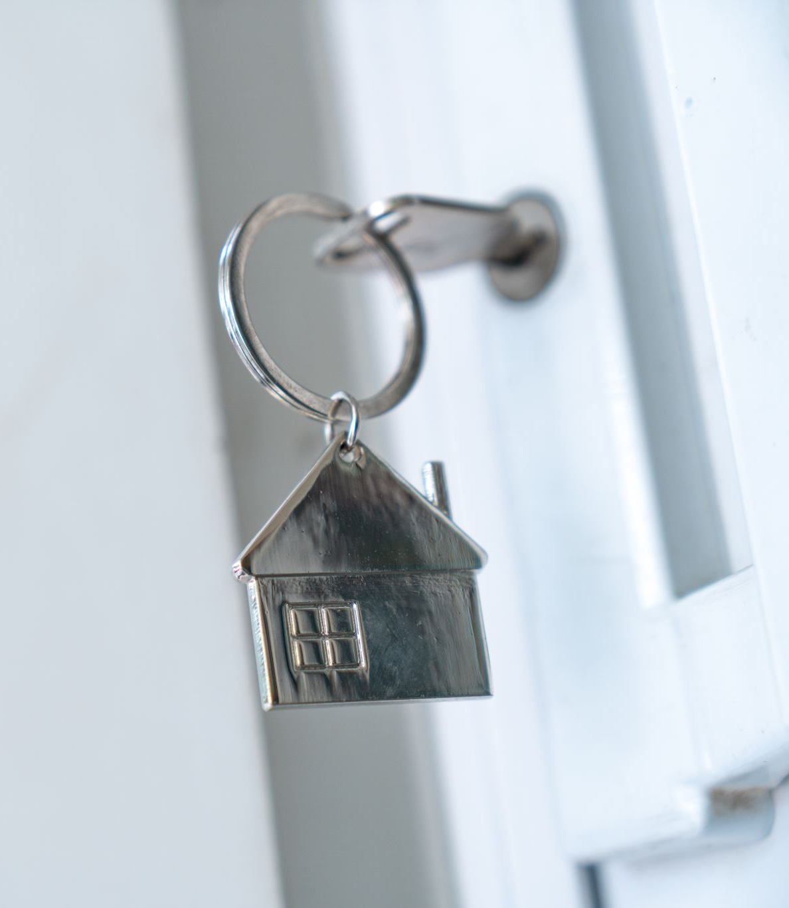
Exploring perth house prices
Predicting Property values

Slide 2
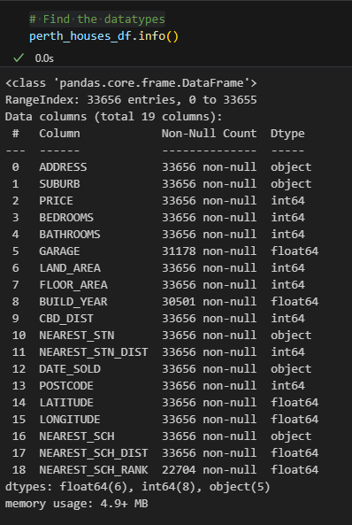
Why I chose this topic?
Notes:
I had initially wanted to do a project based around Spotify and Genres (specifically rock and metal music) I searched online for a suitable dataset but was unable to find one that suited my specific needs. I looked at using a Spotify API but wasn’t fully confident in being able to do that. I briefly considered looking at the ASX for suitable datasets but also looked at Australian Housing market and was lucky enough to come across the Perth House Prices Data set on Kaggle. It gave lots of information and I felt confident in being able to create a project from this.

Slide 3
objective
Create a machine learning model that will successfully predict house prices

Slide 4
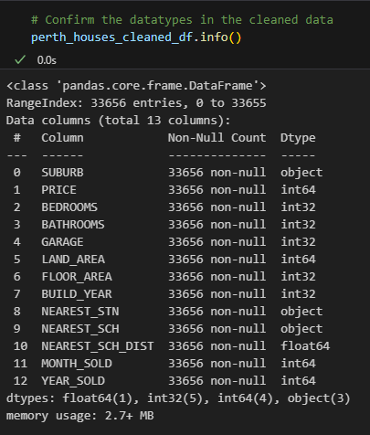
Data cleaning and preprocessing
Check
Check DataFrame for null values.
Convert
Convert Garage values to Integer and replace null values with ‘0’.
Convert
Convert Build Year values to Integer and replace null values with the median year.
Convert
Convert Date_Sold to Month and Year.
Remove
Remove unwanted columns
( Address, CBD_Dist, Nearest_Stn_Dist, Postcode, Date_Sold, Latitude, Longitude & Nearest_Sch_Rank)
Notes:
“Read the slide”
I had initially planned to remove all the data relating to the Date_Sold and Build_Year columns but in the end, I decided to keep them in as I thought this may assist my models by giving it extra information and help in the testing process.

Slide 5
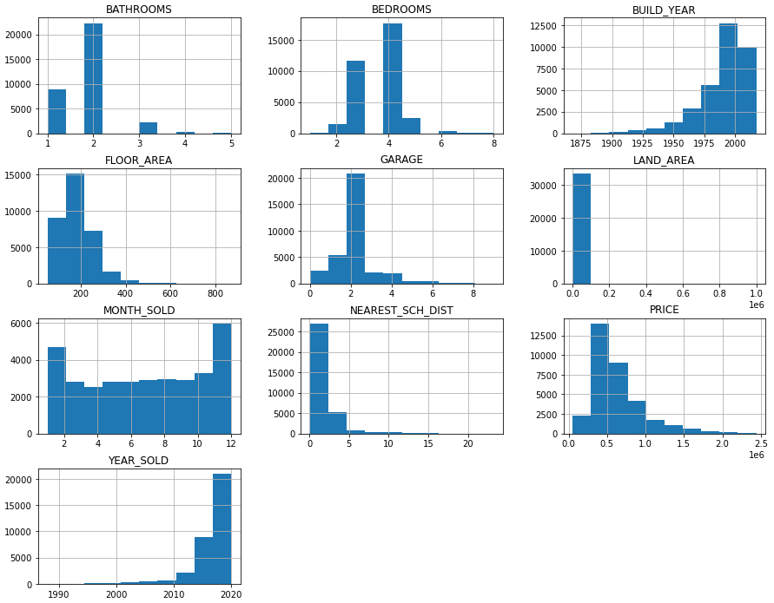
Clean data histograms
Notes:
Once I had cleaned the data. I created these histograms for the remaining data.
The bedrooms, bathrooms, garage and floor area columns were all cleaned, and any outliers were updated to represent the median value for each column. Floor Area was updated to represent the 25th percentile as I believe this would be a better representation of the Floor Area data.
I had also attempted to clean the Land Area data, but this made little to no difference to the histogram and resulted in a poor test score on the Linear Regression Model. So, in the end decided to not adjust the Land Area data.
Looking through the information, we can make the following observations.
* A typical Perth house has 2 bathrooms, 4 bedrooms, is built after 1975 with a floor area of around 200m2, a double garage and is close to schools.
* A house is sold around the $500,000 mark and most likely to be sold in the summer months (December and January specifically).
* The last 5 years has shown strong house sales.

Slide 6
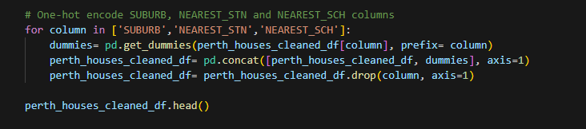
Final STEP of the preprocessing stage
get_dummies was then used on the following
Suburb
Nearest_stn
Nearest_sch
Notes:
Get_dummies was used to transform these categorical variables into a format suitable for the Machine Learning models which would then produce better performance by the models.
Suburb
Nearest Station
Nearest School

Slide 7
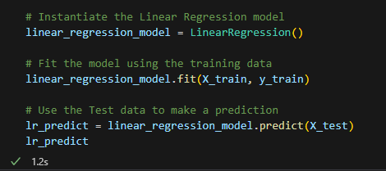
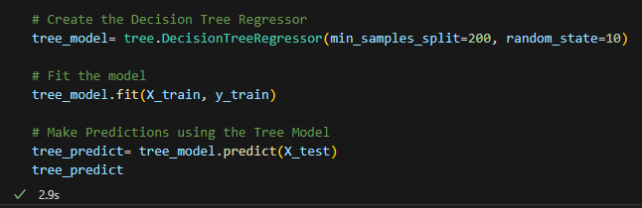
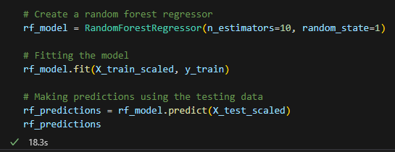
Create machine learning models
Model 1 – Linear Regression Model
Model 2 – Decision Tree Regression Model
Model 3 – Random Forest Regression Model
Notes:
When it had come time to decide what model to use for the machine learning I looked back through class notes and decided to go with the Logistic Regression model, however this one did not work very well. It was taking up to 20-25 minutes to run and my scores were rock bottom. I did some research and realised I had chosen poorly, and that Linear Regression was the best suited model for the data set that I was using. Once I made these changes the model ran much better and was able to achieve a good result.
I wanted to try at running a second model to see if I could achieve a greater score than I had with the Linear Regression? I once again chose poorly and went with the Decision Tree Classifier. When it came to creating a confusion matrix, I continually was given error after error no matter what I tried. Through discussion with my instructors, it was decided to try an alternate model.
This time I decided to work on a Random Forest Classifier model. Initially I was running with high parameters and getting errors so reduced these to a lower value. When running the predict model I was getting an error and after some investigation it was discovered that I was running a classifier model and not a regression model, so once I made the changes and ran it as a Random Forest Regressor Model everything worked, and I was able to get a result.
It was then that I realised that I had also been running my Decision tree model as a classifier and not as a regressor model.
So initially I had planned on running two models and ended up running 3.
I ran the StandardScaler for both the Decision Tree and Random Forest models to standardize the features within the dataframe to help achieve more consistent scales across different features of the data set.

Slide 8
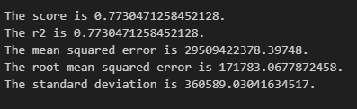
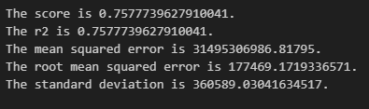
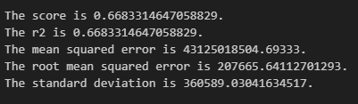
Model results
Linear regression model
DECISION TREE MODEL
Random forest model
Notes:
Here we can see the results.
The linear regression model has the highest score/R2 value, which indicates a better fit to the data and better performance in explaining the variability of the target variable.
The linear regression model has the lowest MSE, (Mean Squared Error) indicating smaller errors in predicting the target variable compared to the other two models.
Like the MSE results, the linear regression model has the lowest RMSE (Root Mean Squared Error) value, indicating smaller average errors in prediction.
The standard deviation value is the same for all three models.

Slide 9
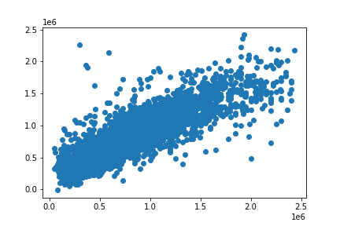
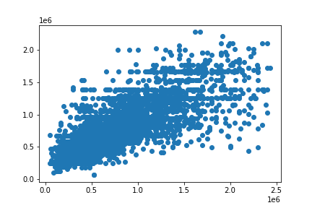
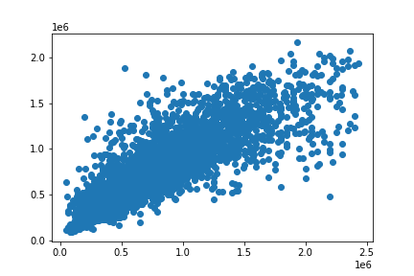
SUMMARY
Linear regression model
DECISION TREE MODEL
Random forest model
Score 77.30%
Score 66.83%
Score 75.78%
Notes:
Of the 3 Regression Models used the Linear Regression Model was the best performer with a score of 77.30%.
While this is an acceptable score some further training would be required in to order to hopefully achieve a better result.
This could be achieved by taking a deeper look into the original data to ensure that the dataset is clean, free of outliers, and contains sufficient instances for training.
Possibly removing further columns such as the Date columns.
Gathering more data, if feasible, can also enhance the model's performance.
Also look at experimenting with the parameters of both the Decision Tree Model and the Random Forest Model.

Slide 10
Tableau visualisations
Notes:
I chose Tableau to be my main visualisation application as this is an area, I would like to focus on in my future Data Analysis career

Slide 11
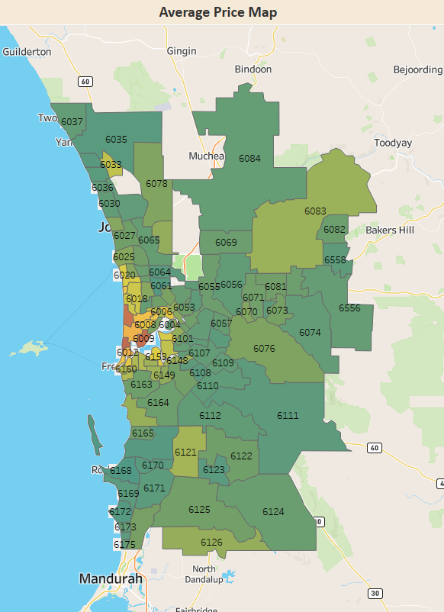
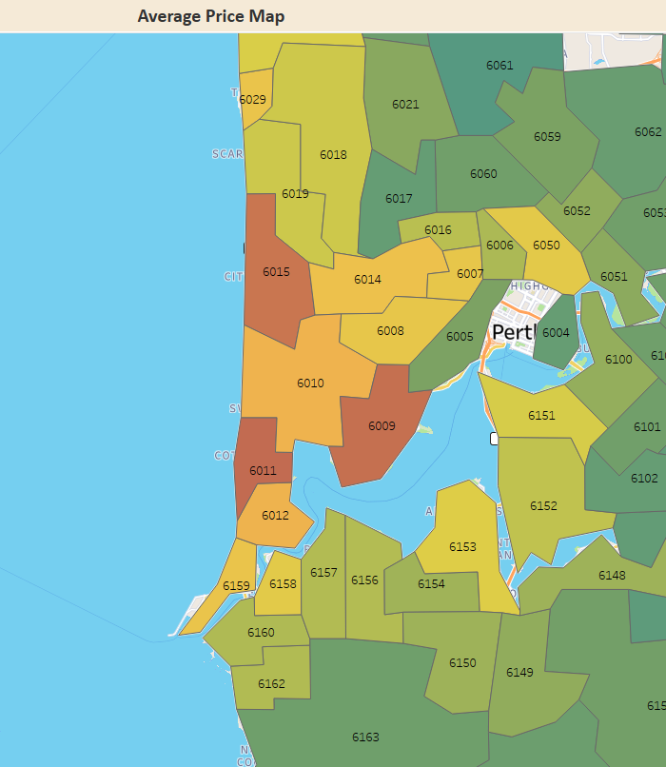
TABLEAU VISUALISATIONS
Coastal Suburbs and those along the Swan River show higher average Sale Prices than the rest of the Perth Area

Slide 12
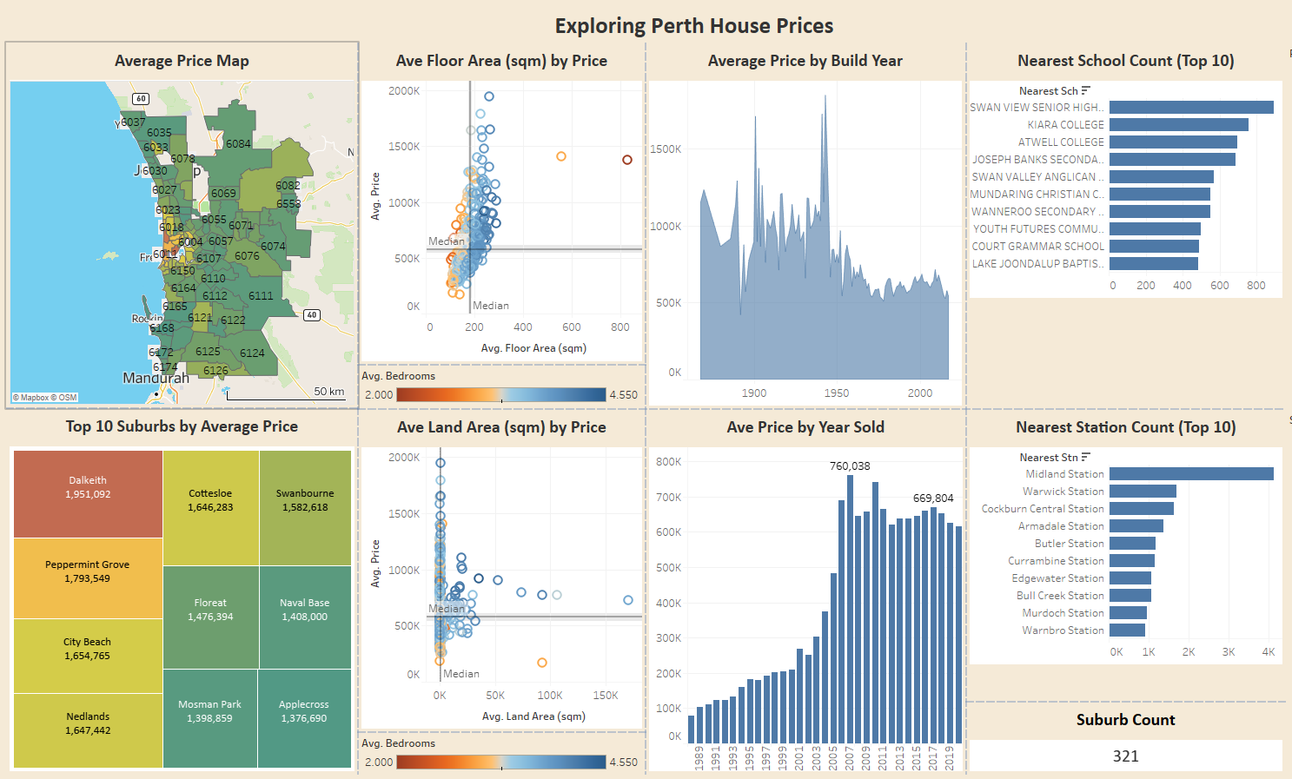
Tableau visualisations
Notes:
Dalkeith is the top Selling Suburb with an Average Sale Price of $1.9 million.
Both Ave Floor Area and Ave Land Area are represented as scatter plots with Average Bedrooms per house shown as a colour filter.
Average Floor Area.
This shows that as the Average Floor Area of the house gets larger so to do the bedrooms increase in quantity.
Naval Base and Wangara both show as outliers on the Average Floor Area chart.
Average Floor Area Median is 180.6 m2
Average Floor Area Median Sale Price is $578,074
Average Land Area Median is 765 m2
Average Sale Price by Build Year shows that homes built pre-1946 tend to have a higher sale price than more modern houses. With a peak of house or houses built in 1943 being sold for an average of $1.85 million
Average Sale Price by Year Sold show that since 2006 houses are being sold consistently above $600,000.
Swan Valley Senior High School and Kiara College had the highest school counts in the data set. While Midland Station was by far the highest station count.

Slide 13

The end
Thank you for your time.
Any questions??

